Slide 1
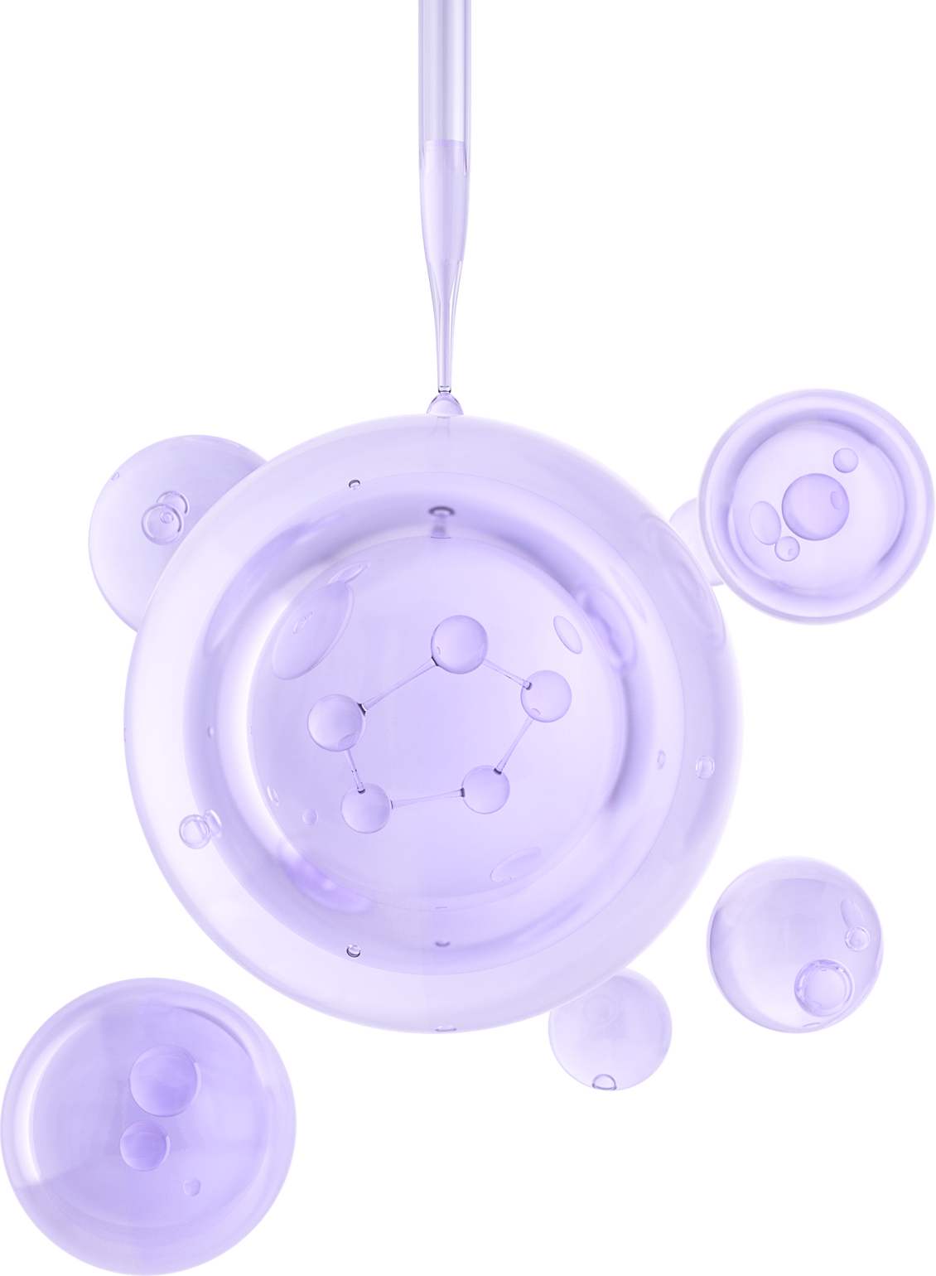

UNIVERSITY OF BASRAH / COLLEGE OF SCIENCE
LECTURE PhD. 2
Peptidoglycan
Department of Biology
Prof.Dr. Saad S. Mahdi Al-Amara

Slide 2
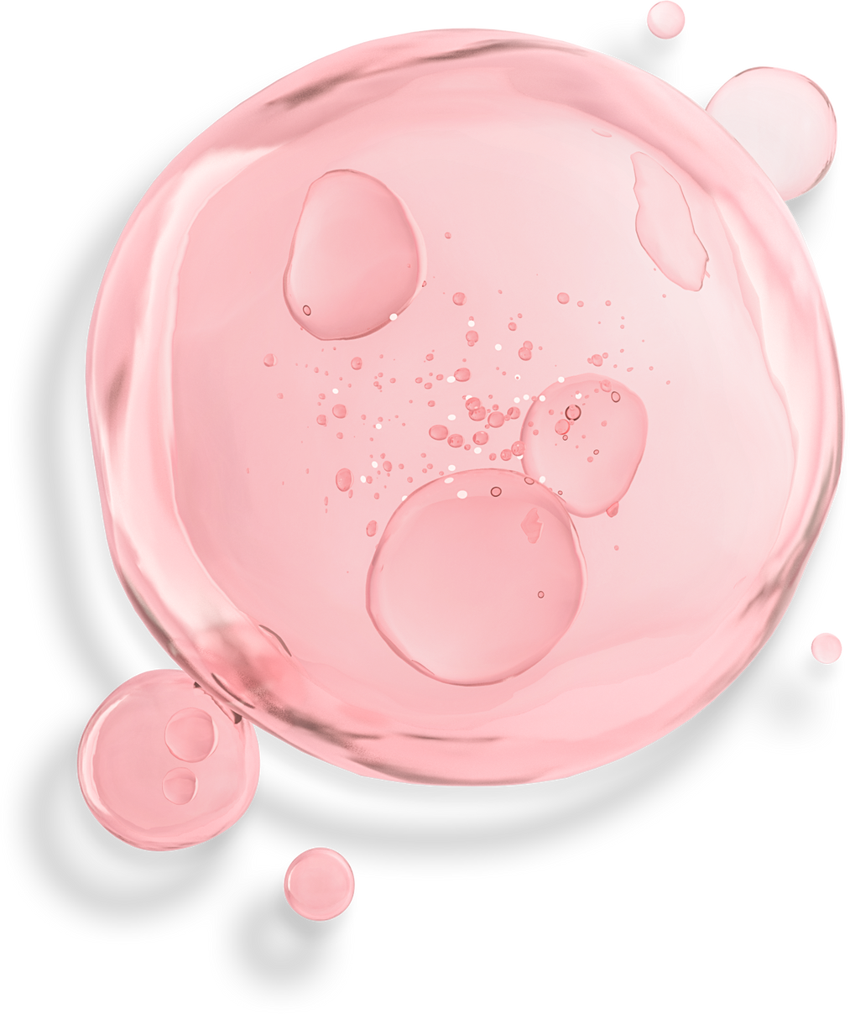
Peptide cross-bridging between peptidoglycan strands is considered to provide structural rigidity to the cell. This is certainly the case in Gram-positive cells in which the multilayered network of cross-linked peptidoglycan ranges between 20 and 40 nm in thickness.
In Gram-negative cells the peptidoglycan layer is much thinner (2–6 nm),
and in most organisms it is probably only a few monolayers in depth. This difference in thickness between gram-positive and gram-negative peptidoglycan layers is generally invoked to explain the fundamental difference in staining with crystal violet (gram stain). Gram-negative bacteria, support from other structures such as the outer
membrane with its embedded proteins may provide the additional support required to withstand the turgor pressure from within the cell.

Slide 3
Some organisms possess cell envelopes that are intermediate between these two general types. The cyanobacteria possess envelopes with a combination of these features.
Cyanobacteria have a general structure more closely resembling Gram-negative bacteria, their peptidoglycan layers range from 10 to 35 nm, depending on the species examined.

Slide 4
Peptidoglycan (Murein) Hydrolases
Almost all bacteria produce peptidoglycan (murein) hydrolases - enzymes that hydrolyze bonds in the peptidoglycan structure. These enzymes are of three basic types:
1. Glycan-strand hydrolyzing
a. Endo-N-acetylmuramidases
b. Endo-N-acetylglucosaminidases
2. Endopeptidase hydrolyzing
a. Peptide bonds in the interior of the peptide bridges
b. Bonds involving the C-terminal D-alanine residue
3. N -acetylmuramoyl-L-alanine amidase
Acting at the junction between the glycan strands and the peptide units

Slide 5
Activation of certain of these hydrolases, particularly under conditions of external stress, may result in cellular autolysis. In fact, it is now considered that triggering of murein hydrolases or other autolysins by environmental stress is responsible for programmed cell death (sometimes referred to as apoptosis).
Bacterial cells contain a variety of penicillin-binding proteins (PBPs). These membrane-bound PBPs interact covalently with penicillin and other β-lactam antibiotics.
The five high-molecular-weight PBPs (1A, 1B, 1C, 2, 3) are involved in peptidoglycan biosynthesis. Both PBP1A and PBP1B are associated with cell elongation. PBP2 aids in determination of cell shape, and PBP3 mediates septum formation.

Slide 6
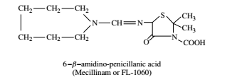
The structural similarity between penicillin and the pentapeptide precursor of the bacterial cell wall allows the β-lactam antibiotics to interact with the active site of a transpeptidase .
Mecillinam, a β-lactam with an amidino side chain, as shown in the structure below, appears to have a different mode of action from that of other penicillins:

Slide 7
Gram-negative organisms such as E. coli are greater than 100 times more sensitive to this agent than Gram-positive organisms such as S. aureus or B. subtilis.
Other penicillins may bind with more than one PBP, but mecillinam binds specifically to PBP2 of E. coli, causing the formation of protoplasts without effect on the activity of other known penicillin-sensitive sites.
The action of different classes of penicillins at different sites suggests that combinations of agents from the two classes of compounds may act synergistically.

Slide 8
Synergy has been demonstrated between mecillinam and a variety of other penicillins and cephalosporins both in vitro and in vivo. Similarly, N-formimidoyl thienamycin and cephoxitin exhibit synergistic killing action on E. hirae, suggesting at least two sites of action of these β-lactams
One block
In the cell division cycle, induced by N-formimidoyl thienamycin or methicillin, occurs before the completion of chromosome
replication.
Second block
induced by cephoxitin or cephalothin, takes place later in the cell division cycle.

Slide 9
Staphylococci resistant to the action of methicillin and other β-lactam antibiotics produce β-lactamase, encoded by blaZ, which hydrolyzes the β-lactam ring.
They also produce the penicillin-binding protein PBP2A, a product of the mecA gene. The PBP2A protein substitutes for other PBPs, but because of its low affinity for methicillin and other β-lactams, it does not bind these agents at a clinically effective level.
The sensor-transducer proteins BlaR1 and MecR1, and their respective repressors, BlaI and MecI, regulate transcription of blaZ and mecA.

Slide 10
Cycloserine
a compound chemically related to D-alanine, prevents the incorporation
of D-alanine into muramyl pentapeptide through its inhibitory action on dipeptide synthetase and alanine racemase.
These combined activities result in the accumulation of mucopeptides lacking the terminal D-alanine.
Insertion of new material into the expanding murein layer requires the activity of enzymes that degrade the glycan strand and endopeptidases that degrade the intact murein polymer.

Slide 11
E. coli produces two soluble lytic transglycosylases (encoded by slt and mlt) that catalyze the cleavage of the β-1,4-glycosidic bond between
N-acetylmuramic acid and N-acetylglucosamine. At the same time.
An intramolecular transglycosylation at the N-acetylmuramic acid residue, resulting in the formation of a 1,6-anhydro bond.
These enzymes apparently play a major role in recycling peptidoglycan components during expansion of the murein layer.
For additional the role of genes involved with murein synthesis during the process of growth and cell division

Slide 12
Teichoic acids (TAs)
are found in all Gram-positive organisms but are absent in Gram-negative bacteria.
Teichoic acids are polymers of either ribitol phosphate or glycerol
phosphate in which the repeating units are joined together through phosphodiester linkages .
Sugars, amino sugars, or amino acids may be condensed to
the hydroxyl groups of the ribitol or glycerol to provide wide variations in overall structure .
Teichoic acids include all polymers containing glycerol phosphate or ribitol phosphate associated with the membrane, cell wall, or capsule. Wall TAs are covalently linked to peptidoglycan through muramic acid and
the phosphate group of ribitol or glycerol phosphate.

Slide 13
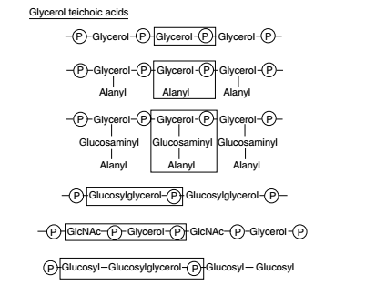

Slide 14
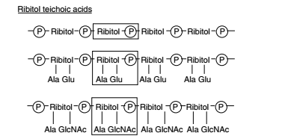

Slide 15
Lipoteichoic acids (LTAs)
are membrane-associated polymers characteristic of Gram-positive bacteria.
The LTAs are linear polymers of 16 to 40 phosphodiester linked glycerol phosphate residues covalently linked to a membrane anchor (generally a glycolipid or glycophospholipid).
Physiological roles postulated for LTA include regulation of autolysin activity, electromechanical properties of the cell wall, and interaction of bacteria with cells of infected hosts.

Slide 16
THANK YOU

